Slide 1

Artificial Intelligence und Deep Learning in Python

Slide 2
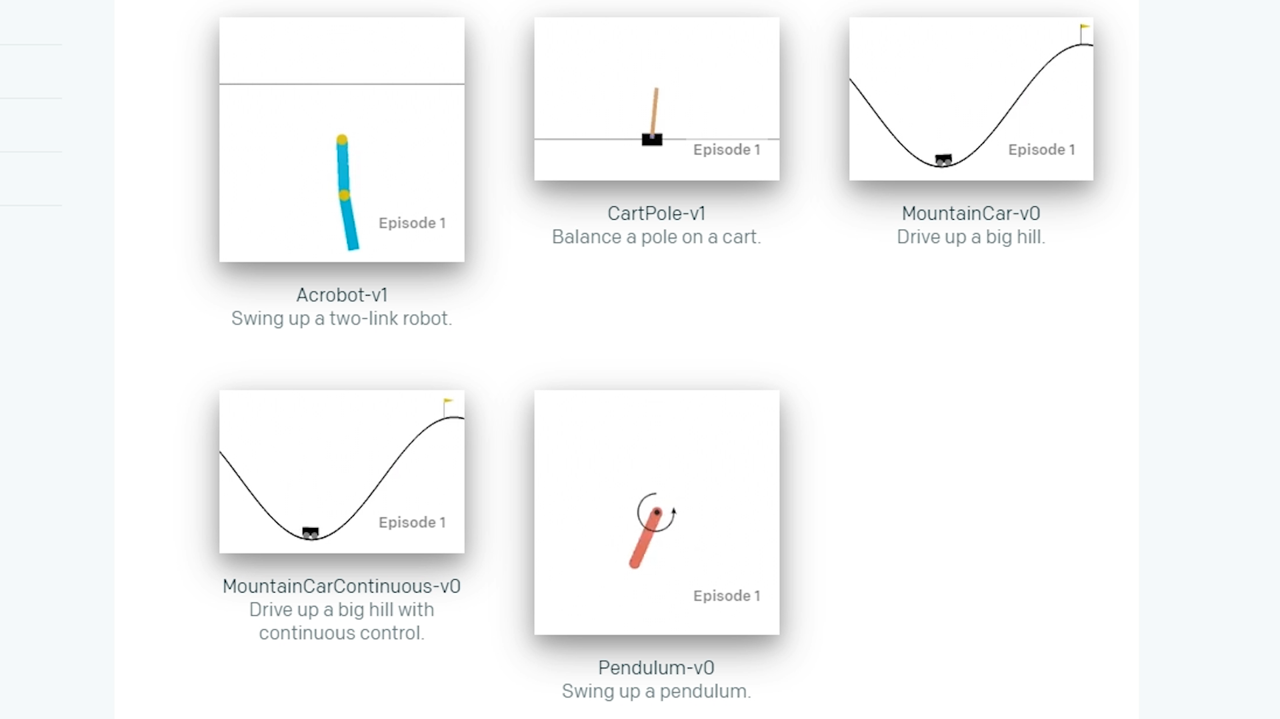
Artificial Intelligence

Slide 3
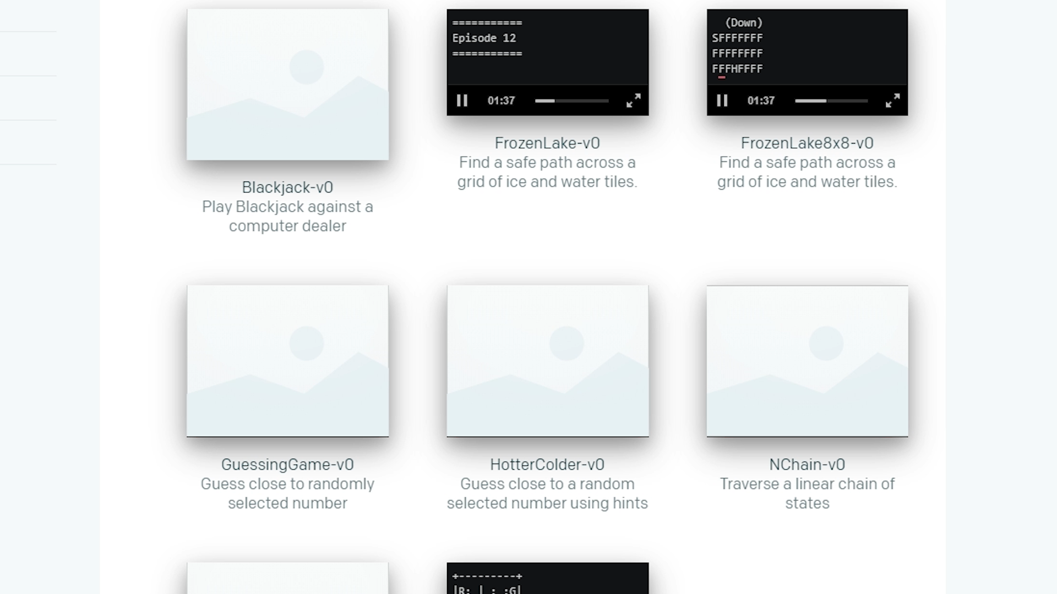
Artificial Intelligence

Slide 4
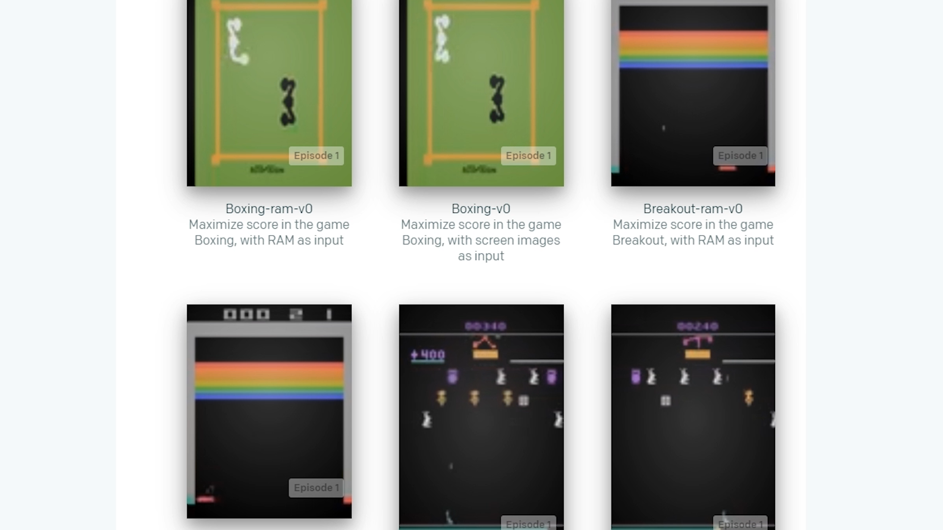
Artificial Intelligence

